Slide 1
Project Name :Singapore Resale Flat Prices Predicting
Name- Vikram Pratap Singh
Master in Data Science- Guvi
Email – sify.vikram@gmail.com

Slide 2
Problem Understanding
The objective of this project is to develop a machine learning model and deploy it as a user-friendly web application that predicts the resale prices of flats in Singapore.
This predictive model will be based on historical data of resale flat transactions.
It aims to assist both potential buyers and sellers in estimating the resale value of a flat.

Slide 3
Solution
The resale flat market in Singapore is highly competitive, and it can be challenging to accurately estimate the resale value of a flat. There are many factors that can affect resale prices, such as location, flat type, floor area, and lease duration.
A predictive model can help to overcome these challenges by providing users with an estimated resale price based on these factors.
This model leverages historical data and advanced machine learning algorithms to analyze and predict the resale prices, offering a valuable tool for both buyers and sellers navigating the market.

Slide 4
Goal of the project
Data Collection and Preprocessing: Collect a dataset of resale flat transactions from the Singapore Housing and Development Board (HDB) for the years 1990 to Till Date. Preprocess the data to clean and structure it for machine learning.
Feature Engineering: Extract relevant features from the dataset, including town, flat type, storey range, floor area, flat model, and lease commence date. Create any additional features that may enhance prediction accuracy.
Model Selection and Training: Choose an appropriate machine learning model for regression (e.g., linear regression, decision trees, or random forests). Train the model on the historical data, using a portion of the dataset for training.

Slide 5
Goal of the project
Model Evaluation: Evaluate the model's predictive performance using regression metrics such as Mean Absolute Error (MAE), Mean Squared Error (MSE), or Root Mean Squared Error (RMSE) and R2 Score.
Streamlit Web Application: Develop a user-friendly web application using Streamlit that allows users to input details of a flat (town, flat type, storey range, etc.). Utilize the trained machine learning model to predict the resale price based on user inputs.
Deployment on Render: Deploy the Streamlit application on the Render platform to make it accessible to users over the internet.
Testing and Validation: Thoroughly test the deployed application to ensure it functions correctly and provides accurate predictions.

Slide 6
Benefit from the project:
The project will benefit both potential buyers and sellers in the Singapore housing market.
Buyers can use the application to estimate resale prices and make informed decisions.
Sellers can get an idea of their flat's potential market value.
The project demonstrates the practical application of machine learning in real estate and web development.

Slide 7
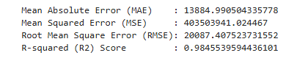
Model Evaluation
The MAE shows the average absolute error between predicted and actual values.
The MSE and RMSE provide insight into the average squared and root squared errors, respectively, with RMSE being in the same units as the target variable, making it more interpretable.
The R² score indicates that approximately 98.46% of the variance in the resale prices can be explained by the model, demonstrating a high level of predictive accuracy.

Slide 8
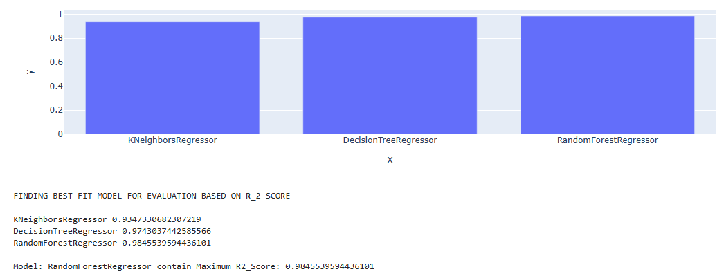
Best Model

